Slide 1
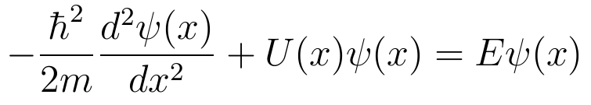
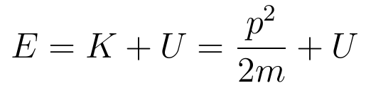
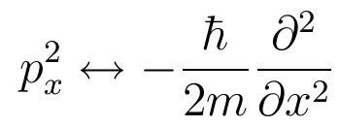
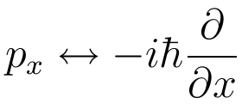
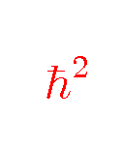
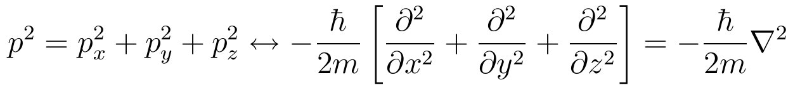
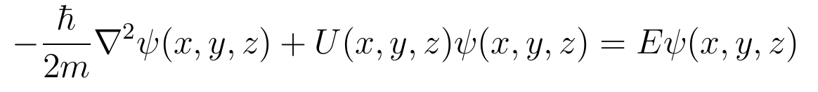
Going into multi-dimensions
Errata
The Schrodinger Equation that we have dealt so far is for single dimension (x):
Recall that we “got” the above equation using:
It is not hard to see that in for motion in one dimension (x), we have “substituted” p_{x}² with an operator:
Thus for three dimensions:
Note that also for slides 7, 10, 11 in lecture 12 : should be

